Slide 1

Measuring 2 port VNA system
08-01-2023
Alexander Don
S2438345
Supervisor: Dr Symon K. Podilchak

Slide 2
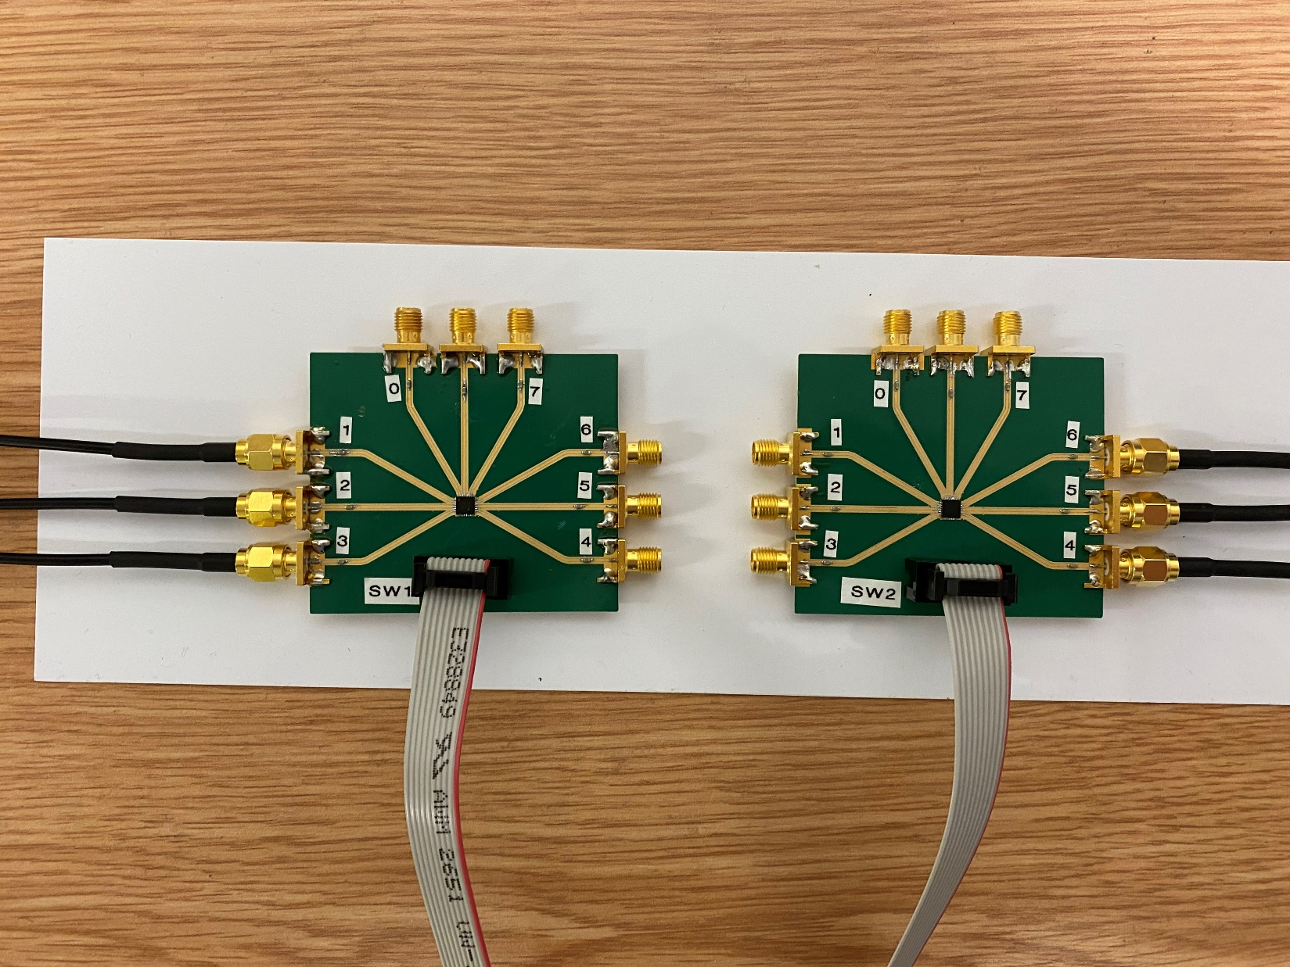
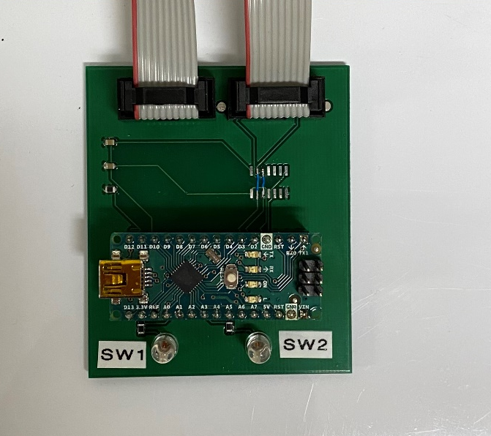
VNA Port 1
VNA Port 2
DUT 4
DUT 3
SHORT
DUT 2
LOAD
OPEN
DUT 1
OPEN
LOAD
THRU
SHORT
Notes:
These are the port labelling's according to Max’s Code

Slide 3
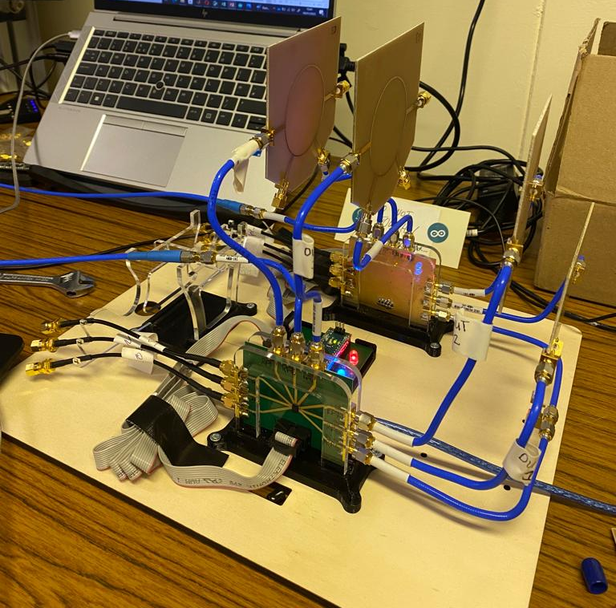
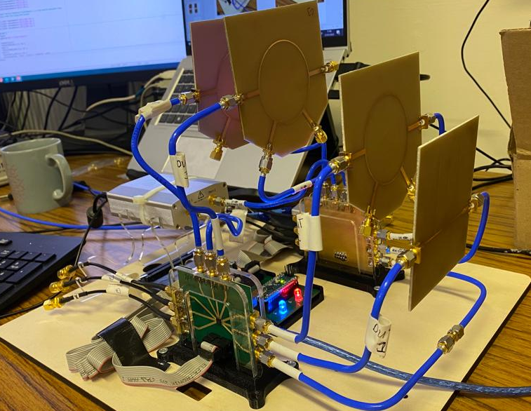
DUT 4
DUT 3
DUT 2
DUT 1
PocketVNA Serial Number: 2.0_1202a0971
Notes:
Physical Setup of the system

Slide 4
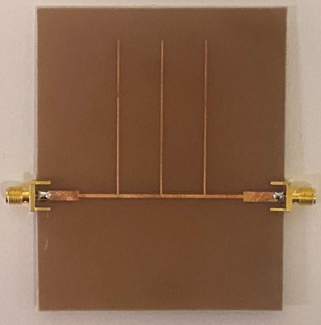
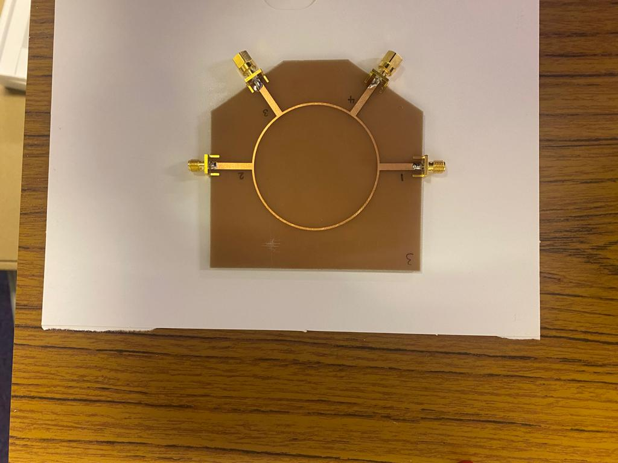
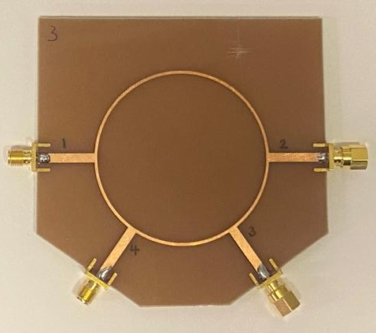
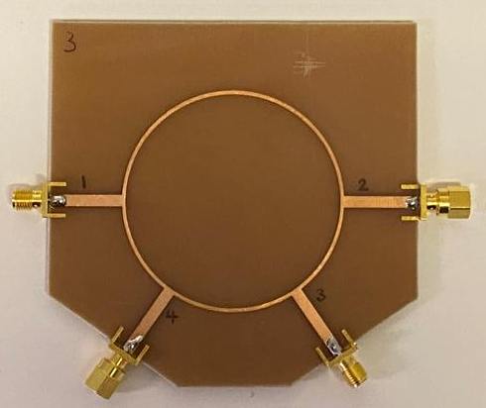
DUT 2
DUT 1
DUT 3
DUT 4
Notes:
The three Devices Under Test (DUT’S)

Slide 5
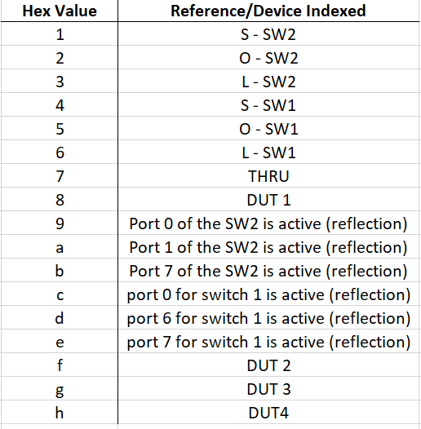
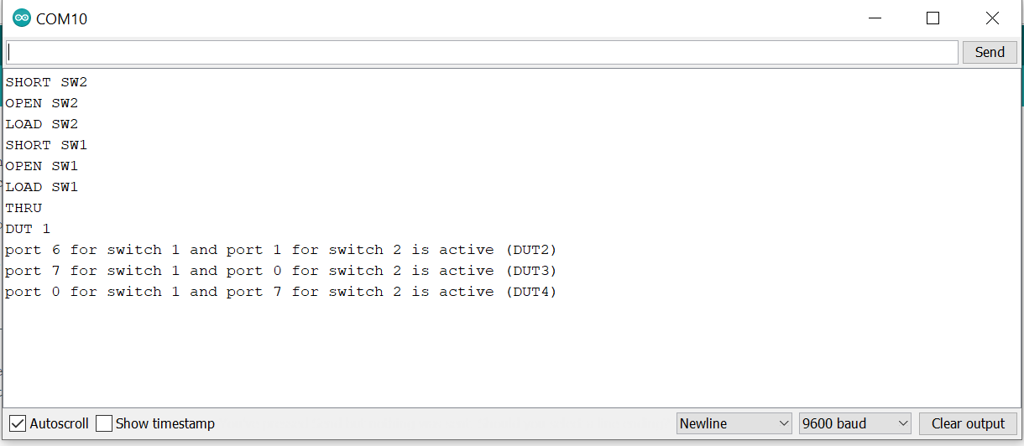
Measurement Index Sequencing
When performing the measurements ( using calibrated VNA or otherwise) the following Hex values are inputted into the serial monitor of the “nano_2p” Arduino code in the order shown.
After each reference/device is indexed then full 2-port measurement are taken of said reference/device and recorded.

Slide 6
Measurement Labels
Ideal Reference – The DUT was measured using the Copper Mountain VNA calibrated using its own standards using its inherent software.
PocketVNA (PVNA) – These are the measured results using the PocketVNA after it has been calibrated using the built-in SOLT standards of the system.
Copper Mountain VNA (CMVNA)– These are the measured results using a professional VNA (Copper Mountain VNA) after it has been calibrated using the built-in SOLT standards of the system.

Slide 7
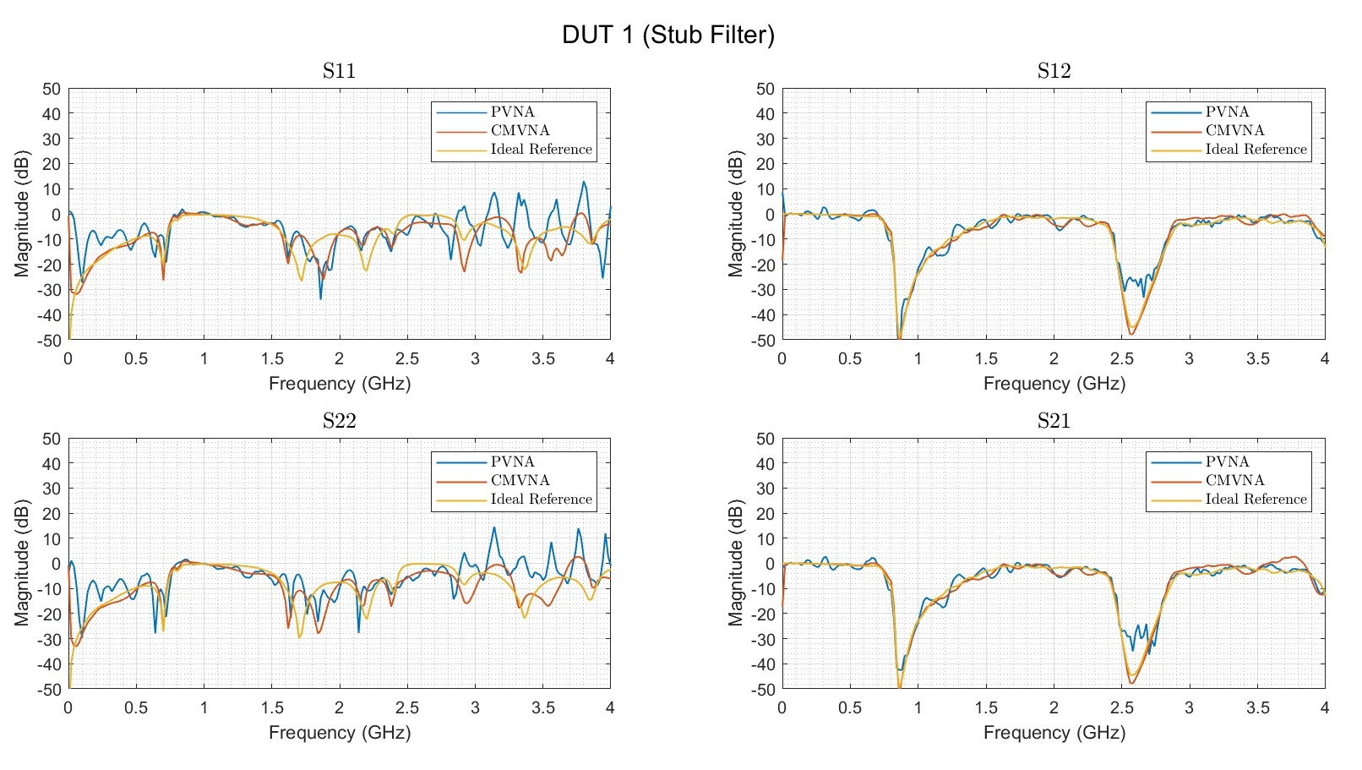
DUT 1

Slide 8
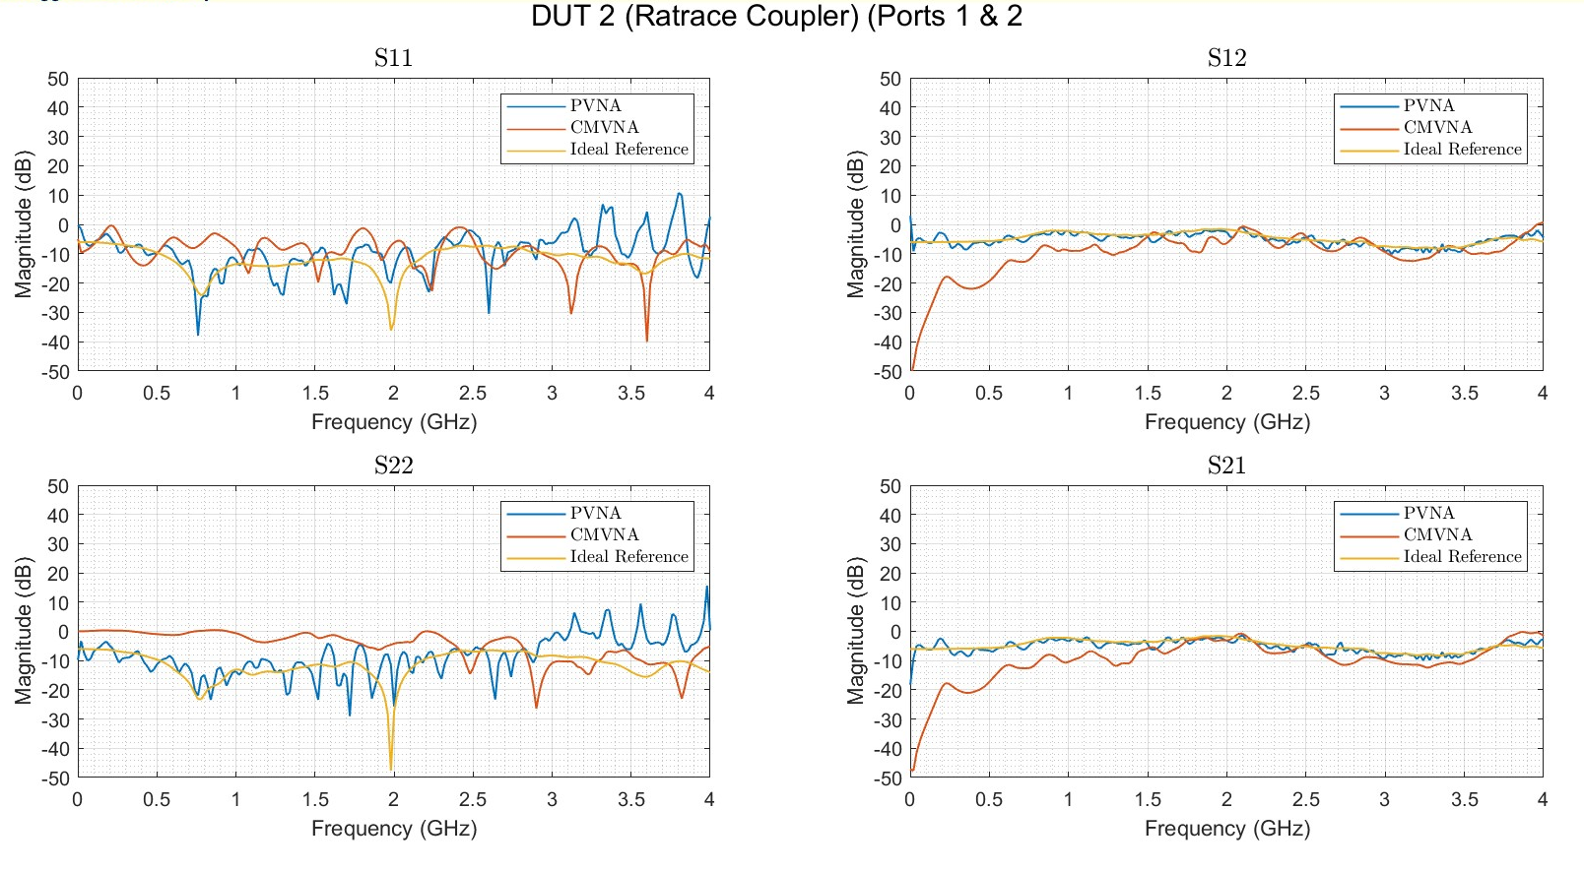
DUT 2

Slide 9
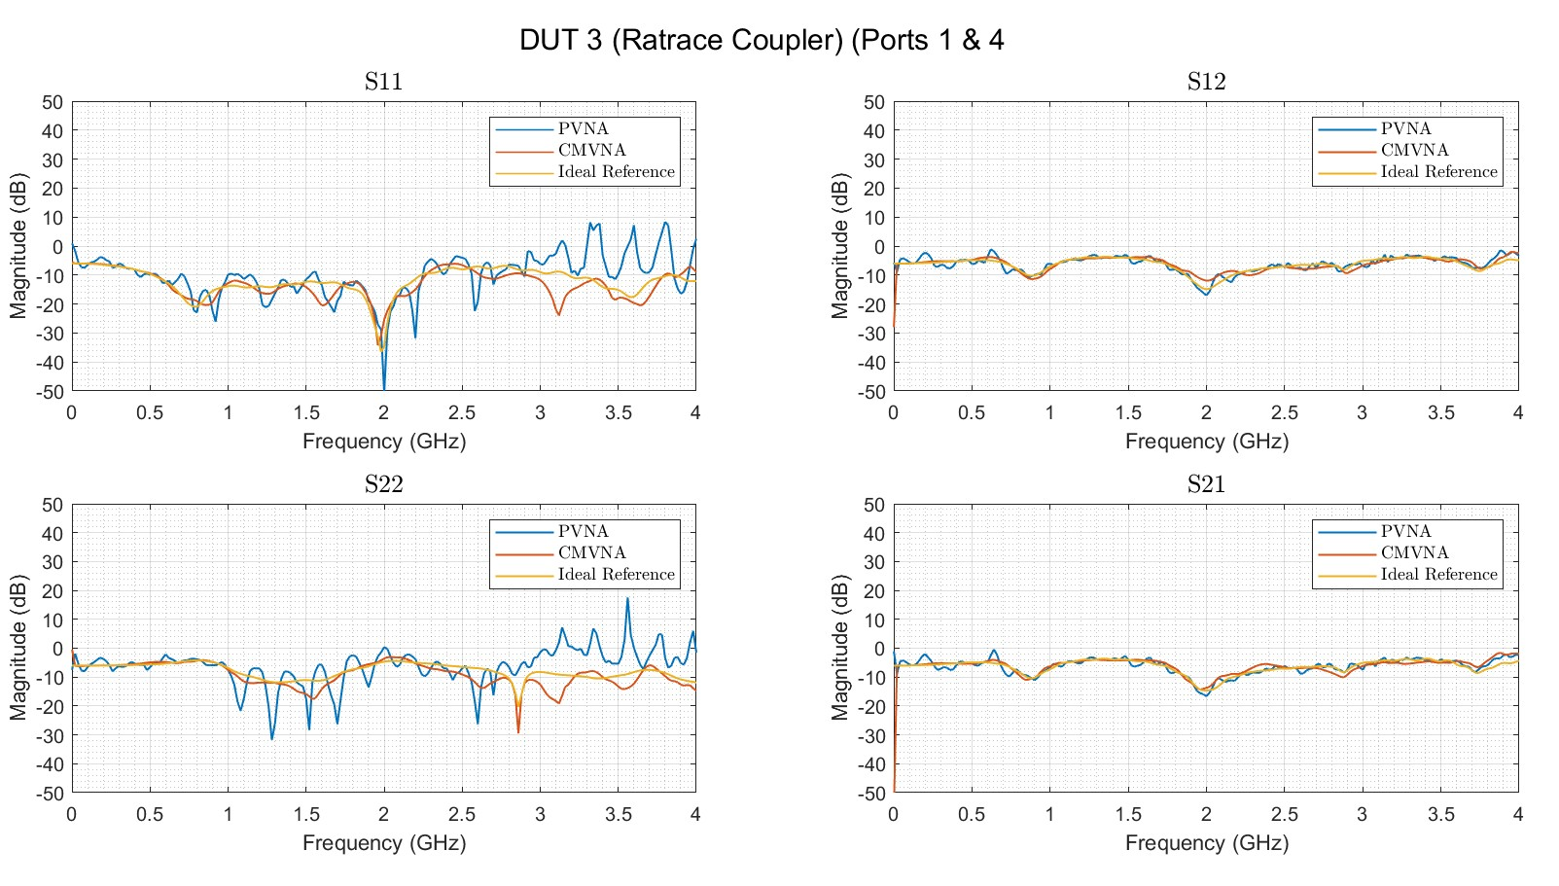
DUT 3

Slide 10
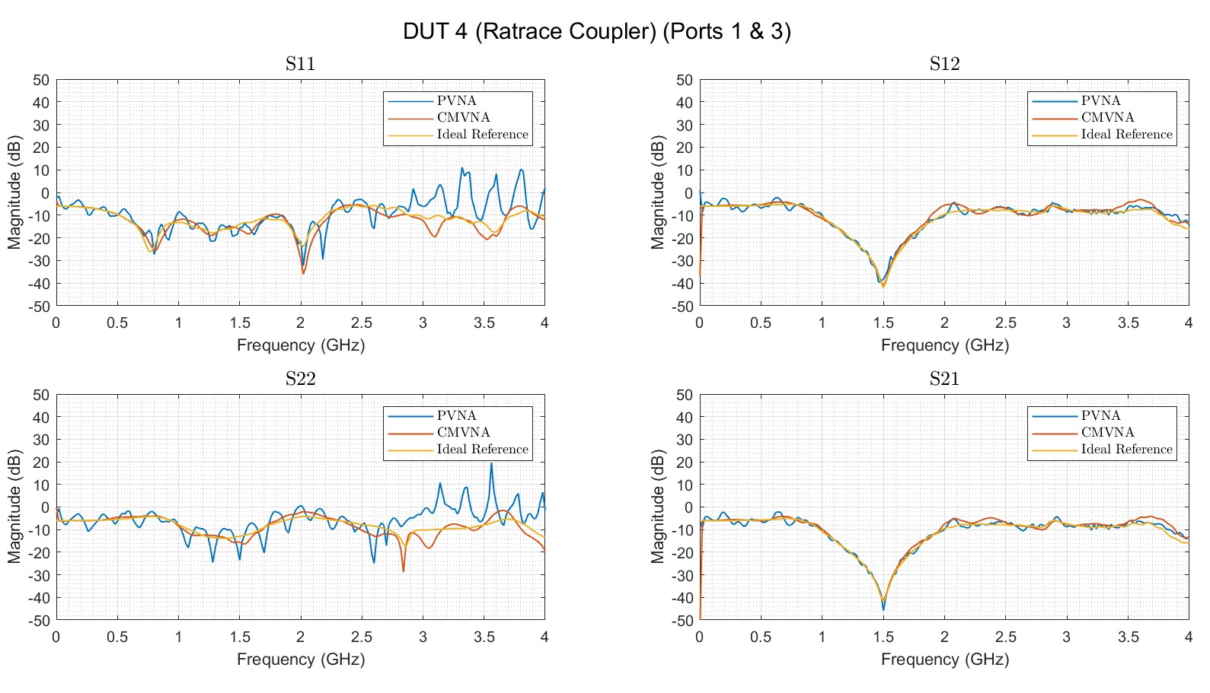
DUT 4

